Slide 1
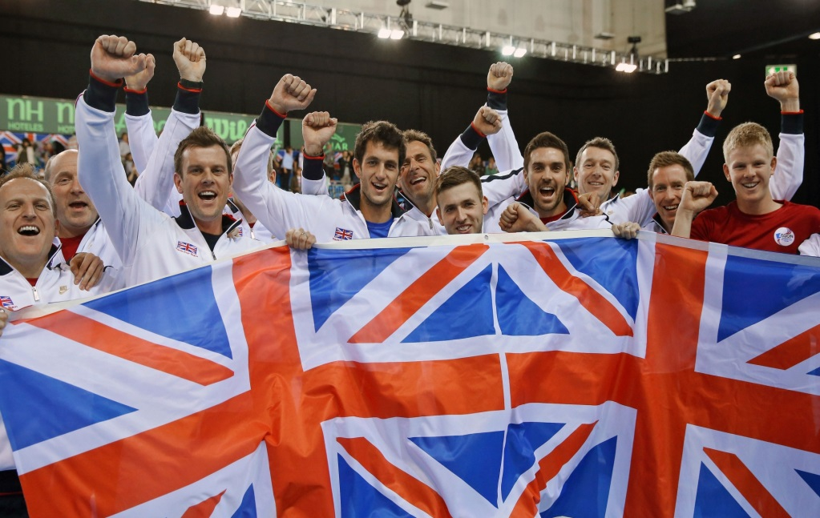
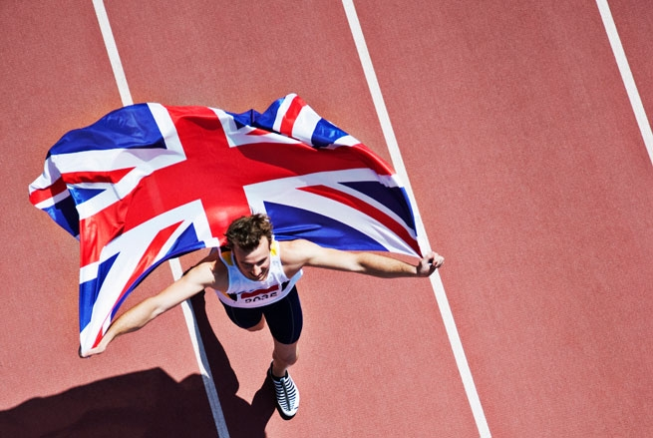
Great British sporting events
Выполнил ученик 10А класса:
Евчев Сергей

Slide 2
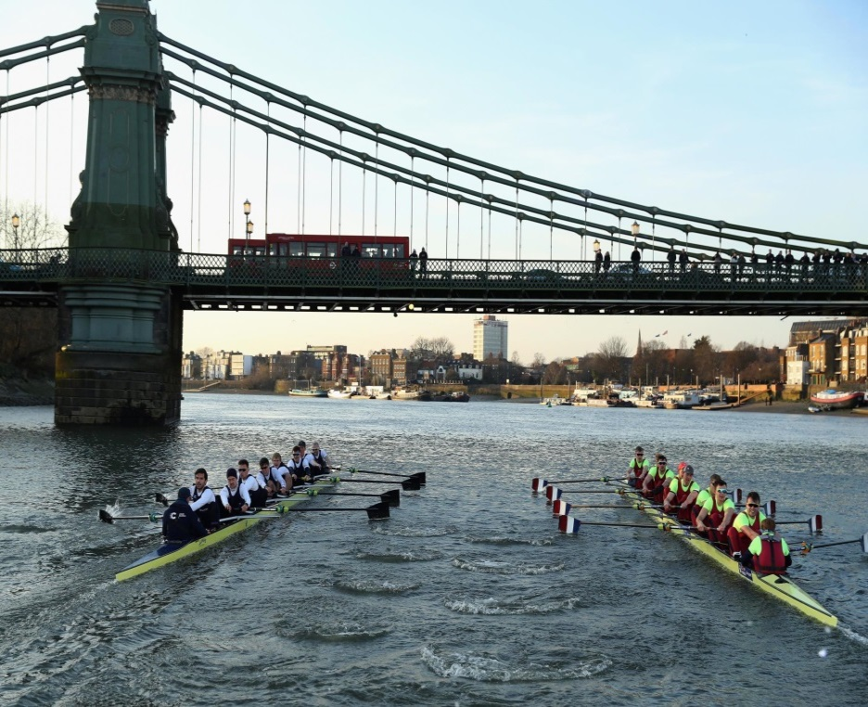
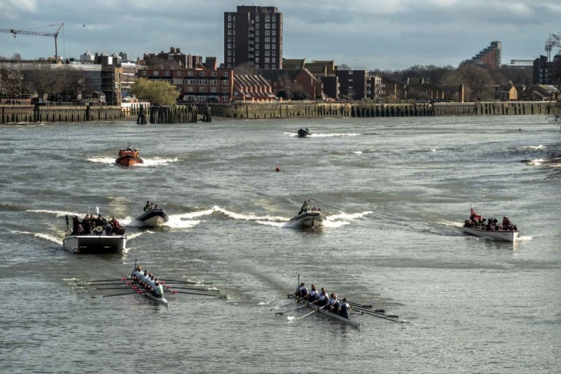
The Oxford and Cambridge Boat Race - boat regatta on the Thames between the teams boat clubs in Oxford and Cambridge universities.
The Boat Race takes place each spring on the River Thames. The 18 competitors (9 in each boat) must be students at Oxford or Cambridge University. They train extremely hard, six days a week for six months before the race.
The Oxford and Cambridge Boat Race

Slide 3
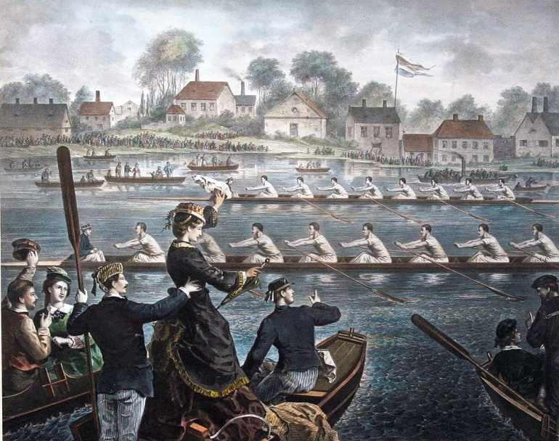
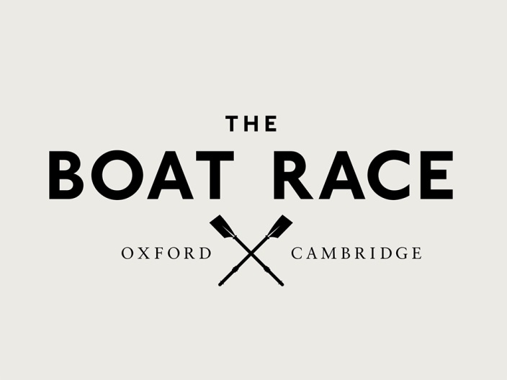
This competition is the oldest and prestigious in the world of rowing.
The first took place on 10 June 1829 at the initiative of the students of Cambridge Charles Merivelja Charles Uordsuorta and Oxford.
From 1856 onwards the regatta was held annually, except for a few years during the world wars.
2020 was the first time that The Boat Race had to be cancelled since World War II.

Slide 4
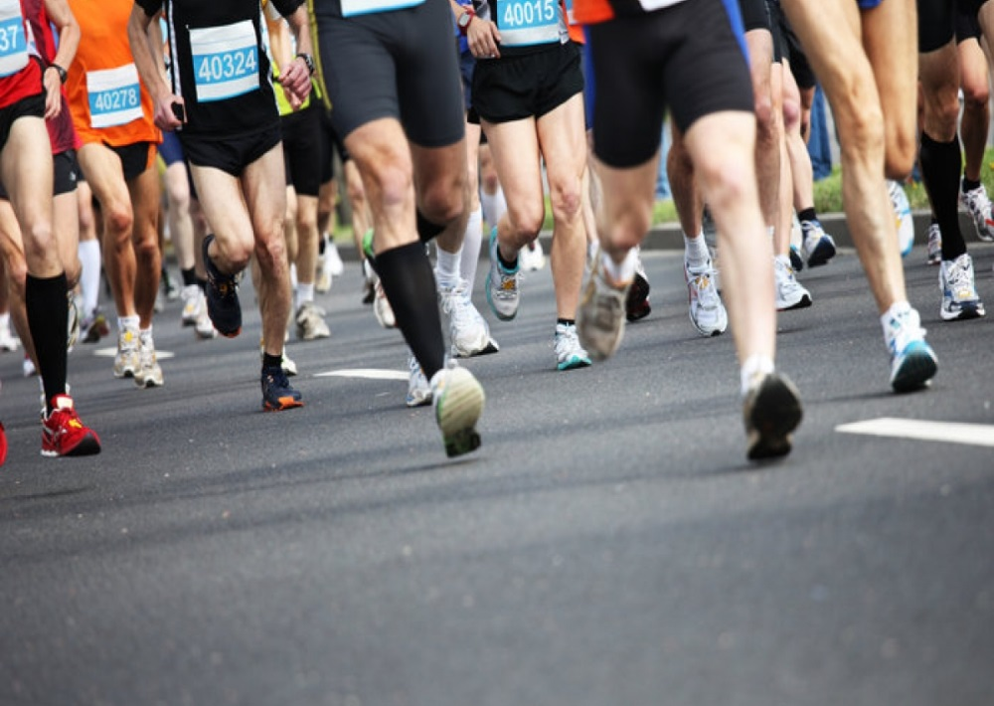
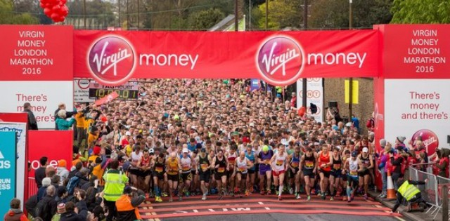
London marathon is one of the most prestigious athletics competitions in the world. The race in the capital of Britain is part of the so-called World Marathon Majors and is held every spring.
This is a series of 5 largest (majors) marathon competitions, which, in addition to London, also includes competitions in Berlin, Boston, Chicago and new York. In the very first race, which took place in 1981, 6747 athletes took part, and in recent years the distance is about 35-40 thousand people.
Virgin Money London Marathon
History The first marathon was organized in 1981 by Olympic medalists in the 3000 m race Chris Brasher and John Disley.

Slide 5
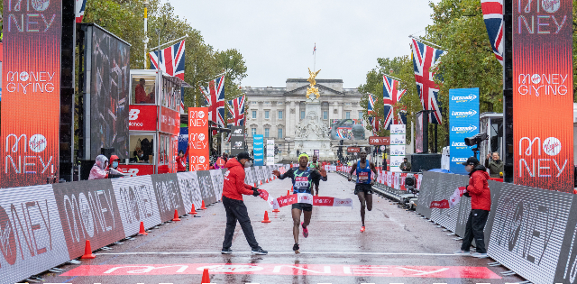
The 2020 London Marathon was originally scheduled to be held on 26 April but was postponed until 4 October due to the COVID-19 pandemic.
It was the first London Marathon to be run in the autumn. On 6 August, it was confirmed that the marathon would go ahead as an elite-only race, with the mass participation event cancelled. Fields of around 30-40 athletes competed for each title. It was the first time that the London Marathon has been an elite-only event. Due to the COVID-19 pandemic, the race was run without spectators, in a biosecure environment.

Slide 6
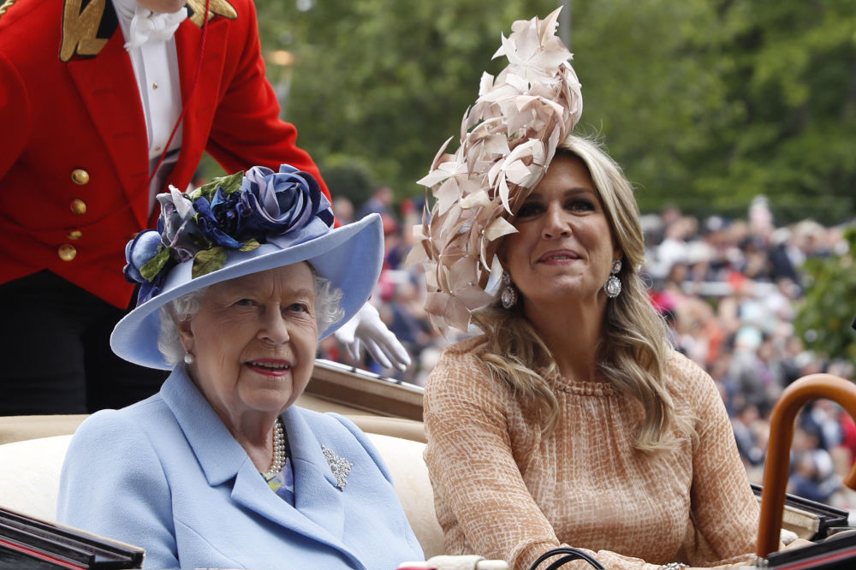
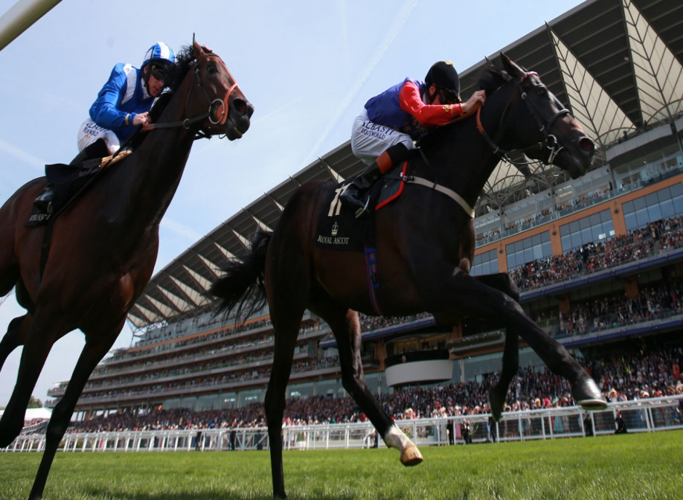
Ascot Racecourse was founded by Queen Anne in 1711, and has since received the patronage of a further eleven monarchs.
The Queen is owner and breeder of many thoroughbred horses and shares her interest in horses with many members of her family.
The names of the week's races have a Royal theme, such as 'King George V Stakes', 'Diamond Jubilee Stakes' and 'Windsor Castle Stakes'.
Royal Ascot

Slide 7
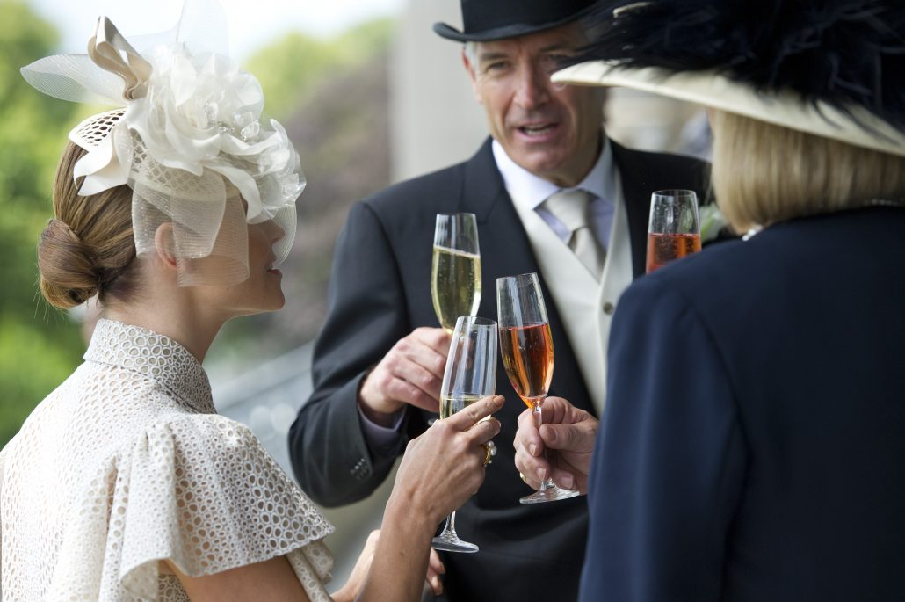
The Ascot dress code reflects the tradition and history of Royal Ascot.
Men are required to wear a full morning suit with waistcoat and either a black or grey top hat at all times.
Ladies must wear a hat with a minimum base of four inches and dresses with a modest cut.
ROYAL ASCOT DRESS CODE

Slide 8
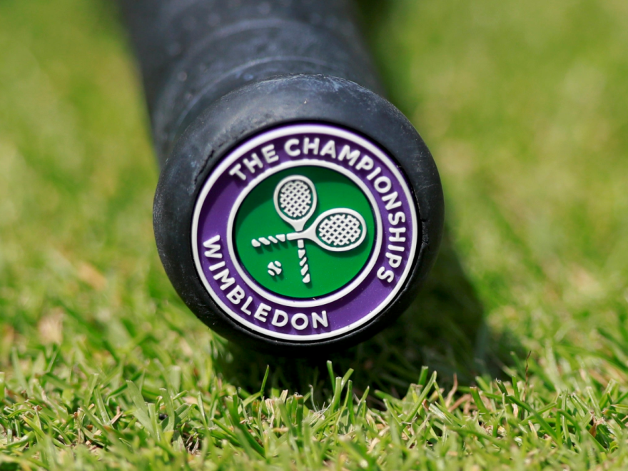
"The Wimbledon Championships" or simply Wimbledon, is the oldest tennis tournament in the world, and widely considered to be the biggest and the most prestigious.
It has been held at the All England Club in Wimbledon, London since 1877.
Wimbledon is the only Major still played on grass, the game's original surface, which gave the game its original name of "lawn tennis".
The Wimbledon Championships

